Slide 1
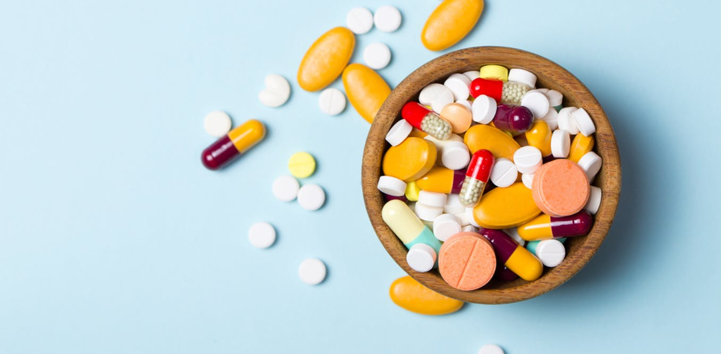
E-MEDICARE
GROUP -1

Slide 2
BATCH -01
FRONT END
Ashish Hanmant Ghule 2478286
Balamkar Rajitha 2478621
G Vishwas 2478550
Gauri Manikrao Mahindre 2478852
Sahithya Subha Mullangi 2479195
BACK END
Alluganti Lakshmi 2478063
Aishwarya Sanjay Mhamane 2478633
Ashish Hanmant Ghule 2478286
Balamkar Rajitha 2478621
G Vishwas 2478550
Gauri Manikrao Mahindre 2478852
Sahithya Subha Mullangi 2479195
Sandip Suresh Kate 2478243
Sawan Kumar Pany 2478362
Govinda Reddy Gari Manasa 2478528
Ashish Gupta 2478295

Slide 3
Contents
Introduction
Objective
Modules for E-Medicare
Tools & Languages Used
System Requirements
Features Available
Admin Flow & User Flow
Screen Shots Of Output
Future & Scope Improvements
Bibliography
Conclusion

Slide 4
E-MEDICARE WEB APPLICATION
INTRODUCTION:
In Present scenario computer is an essential part for human life. It provides better Facilities for storage and retrieval of information related to different areas of application.
The medical stores are looking for the services that are accurate and reliable for providing services to the customers.
The detail of medicine which are available in medical store is easily managed and organized by using this system.
The database for the customers can be managed by using this project.

Slide 5
The project E-Medicare includes registration of user/customer, storing their details into the system, and also computerized .
The software has the facility to give unique ID for every user/customer and stores the details of every customer automatically.
User can search availability of product.
The E-Medicare can be entered using a User Id and Password. It is accessible either by an administrator the data can be retrieved easily.

Slide 6
In this Application we are going to provide online Medicine to the customer’s .
Customer’s can find various types of medicine’s in this application the customer can buy the medicine at reasonable price.
The User Interface is very user-friendly. The data are well protected for personal use and makes the data processing very fast.

Slide 7
Objective:
The Primary objective of the design is to deliver the requirement as delivered by the feasibility report. There are some objective we kept in mind .
The main objective of the project on E- Medicare Application is to manage the detail’s of the customer, medicine company, medicine stock, order expiry date.
It manages all the information about customers, payment, order, customer . The project is totally built at administrative end and thus only the administrator is guaranteed the access.

Slide 8
The Purpose of the project is to build an application program to reduce the manual work or managing the customer, medicine company , payment, medicine.
It tracks all the details about the medicine, medicine stock, order.
Practically : The system is quite stable and can be operated by the people with average intelligence. The Primary objective of the design is to deliver the requirement as delivered by the feasibility report.
Efficiency : We tried to involve accuracy, timeliness and comprehensiveness of system output.

Slide 9

Modules for E-Medicare:
Admin
User
Login
Add Product
View Product
Add to Cart Product
Payment

Slide 10
ADMIN MODULE:
In this module we are going to add the products, delete the products, edit the products. Admin module allows system administrator to set up back-end of the system and perform basic system configuration, mainly definition of predefined drop-down fields, definition of classes time schedule, etc
USER MODULE:
The user module allows users to register, log in, and log out. Users benefit from being able to sign on because this associates content they create with their account and allows various permissions to be set for their roles.

Slide 11
CART MODULE:
A cart module shows the items that have been added to the cart before the customer proceeds to checkout. The module also shows an order summary and lets the customer apply or remove promotional codes. The cart module supports signed-in checkout and guest checkout.
PAYMENT MODULE:
It is used for managing the payment details. Payment module is group of payment features and setting, often made available by third party.

Slide 12
Advantages:
Cost efficiency
Less time consuming
Time-saving
Anytime anywhere
Easy Secured payments
Convenient
Information is private and confidential
Systematic
Facilitate useful information
Future vision

Slide 13
Disadvantages:
Lack Of Security:
The paper document is less secure compared to an electronic system.
Time Consuming:
Manually managing is a very tough and time-consuming process.

Slide 14
System Requirements
The Basic System Requirements for Running this project are listed below:
Angular, STS and Oracle 10G to be installed to the system
572 MB Random Access Memory
200 MB of Free Space on Hard Disk
Microsoft Windows XP or Linux or Equivalent OS
Web Browser Internet Explorer Version 10

Slide 15
Tools & Languages Used
Front End
Visual Studio
Angular
Html
CSS
BOOTSTRAP
Back End
Oracle Server
Spring Tool Suite
Eclipse IDE
Spring Boot

Slide 16
Features Available
Admin
Login
Add or Remove Products
Edit Product Details
Enable or Disable Products
Delete Products
View Customers Data
Customer
Register
Update Profile
Search for Products
Add Products to the Cart
Product Summary Page

Slide 17
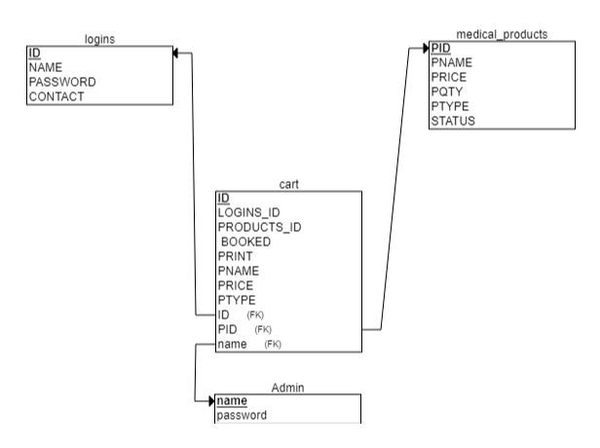
CLASS DIAGRAM:

Slide 18
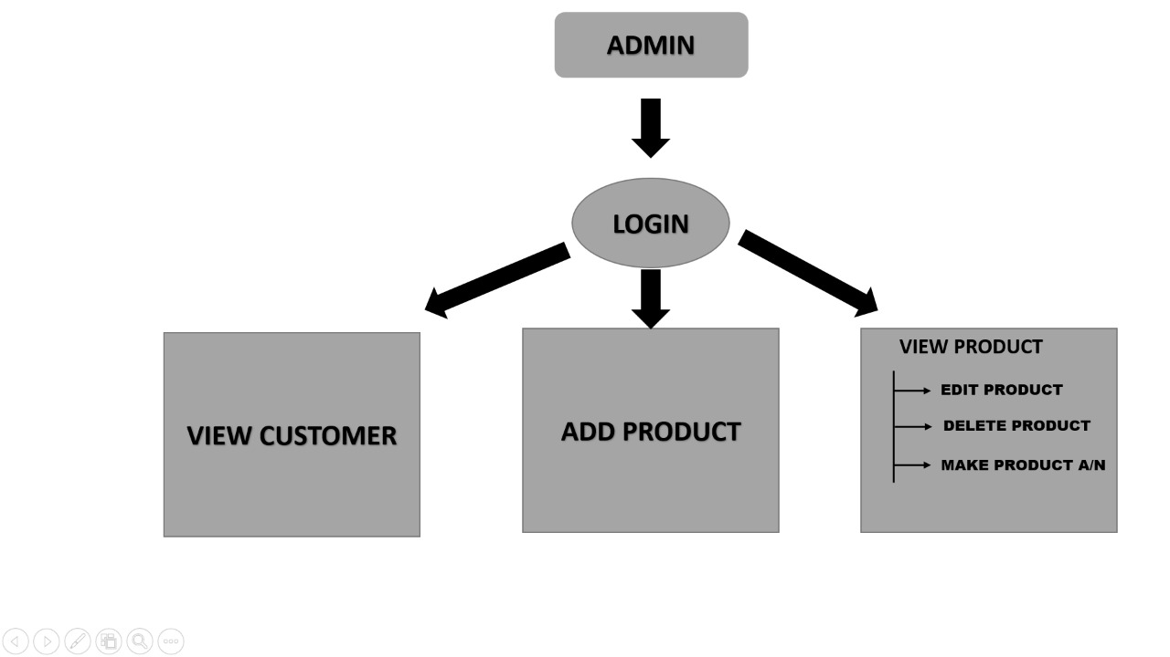
ADMIN FLOW

Slide 19
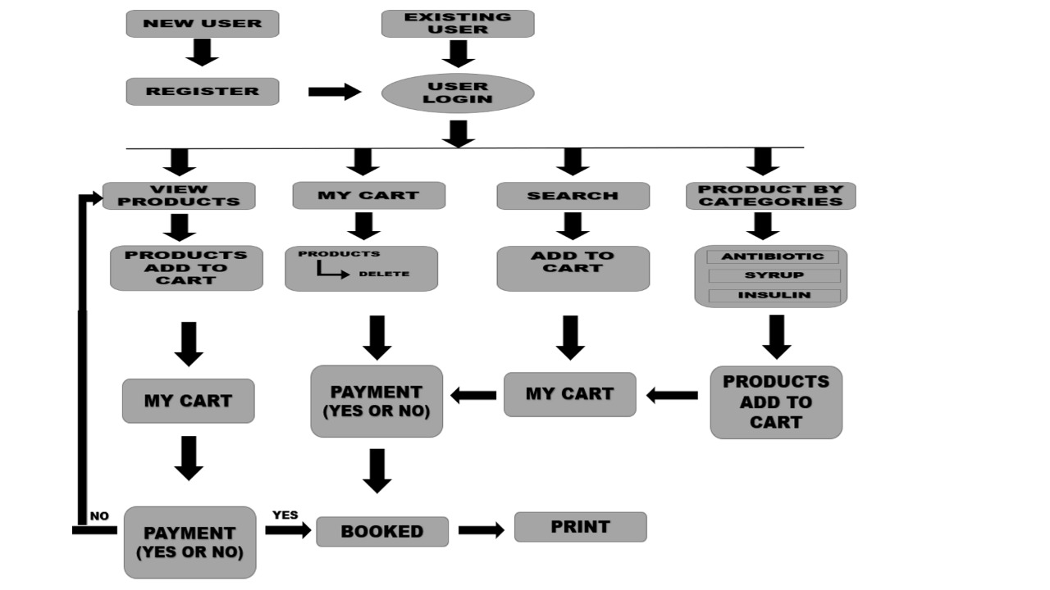
USER FLOW

Slide 20
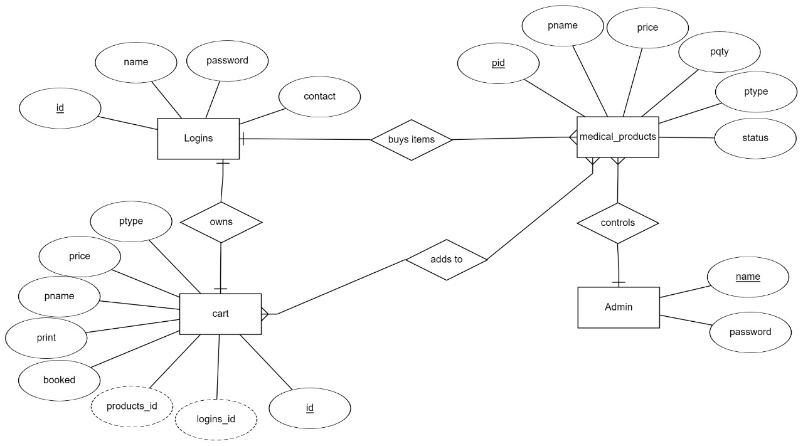
WEB APPLICATION TOTAL FLOW

Slide 21
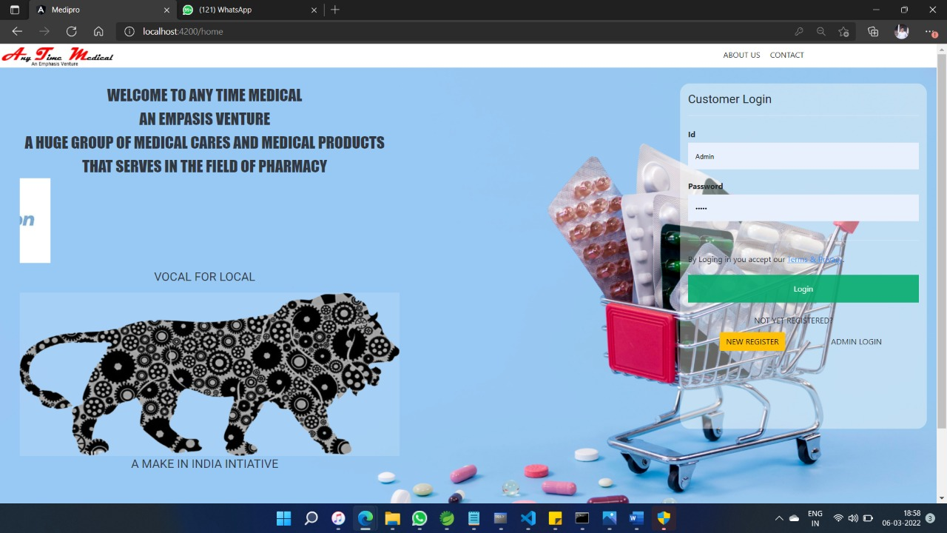
HOME PAGE:

Slide 22
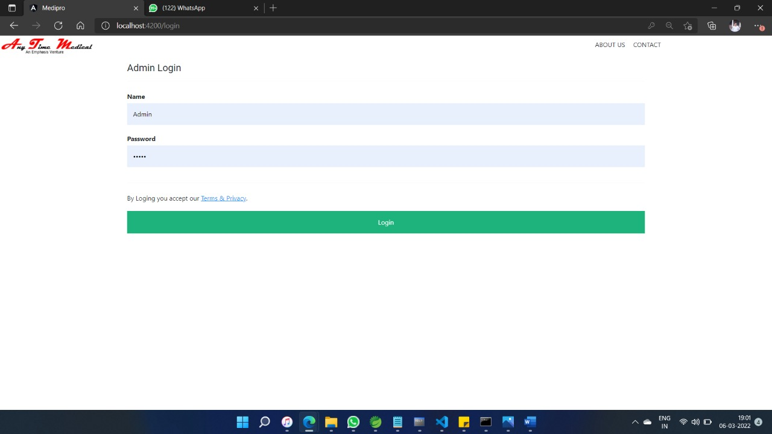
ADMIN LOGIN PAGE:

Slide 23
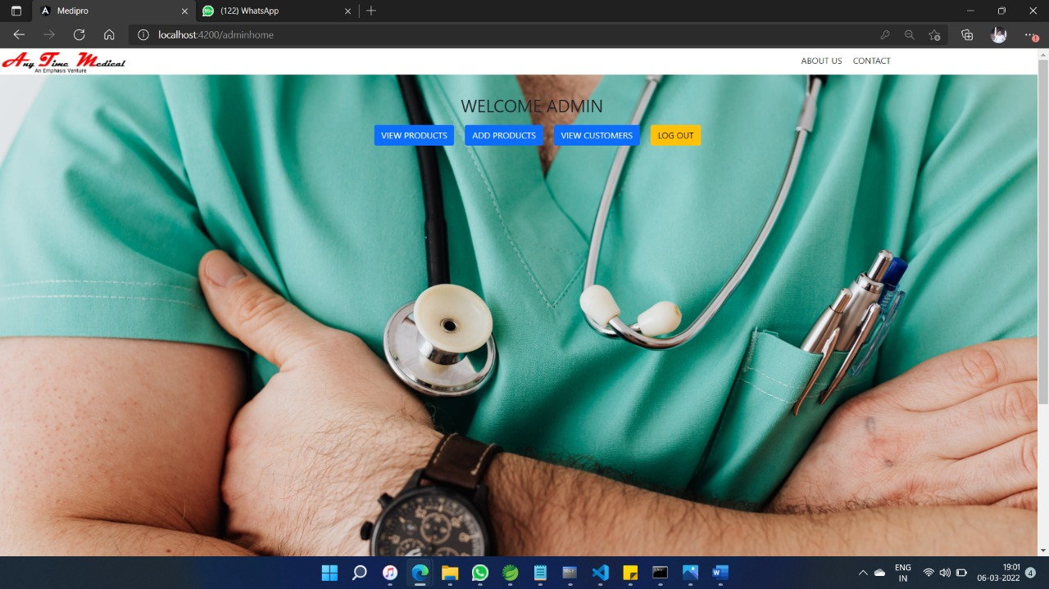
ADMIN DASHBOARD:

Slide 24
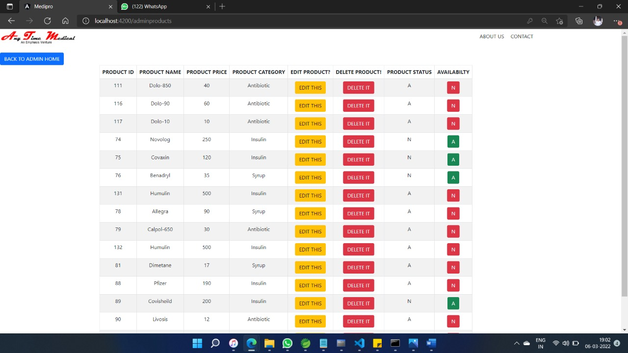
ADMIN VIEW PRODUCTS:

Slide 25
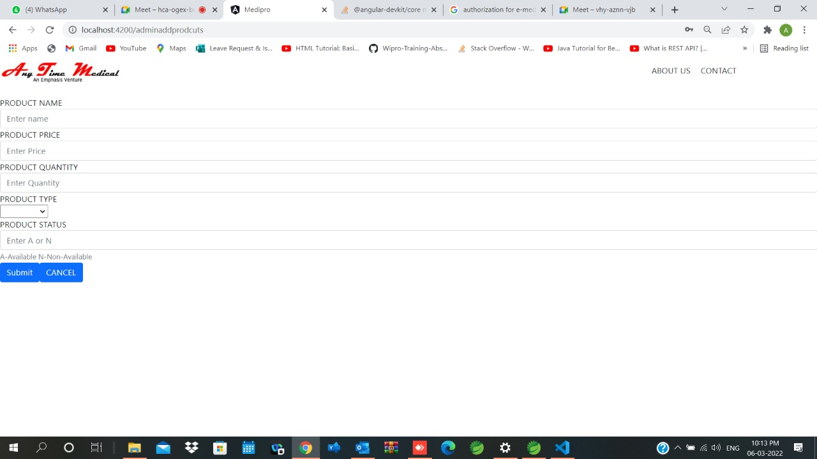
ADMIN ADD PRODUCTS:

Slide 26
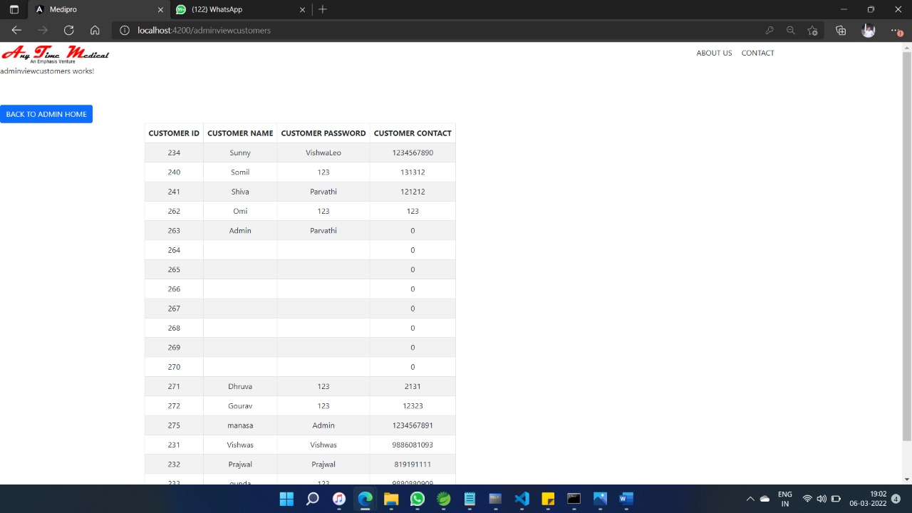
ADMIN VIEW CUSTOMERS:

Slide 27
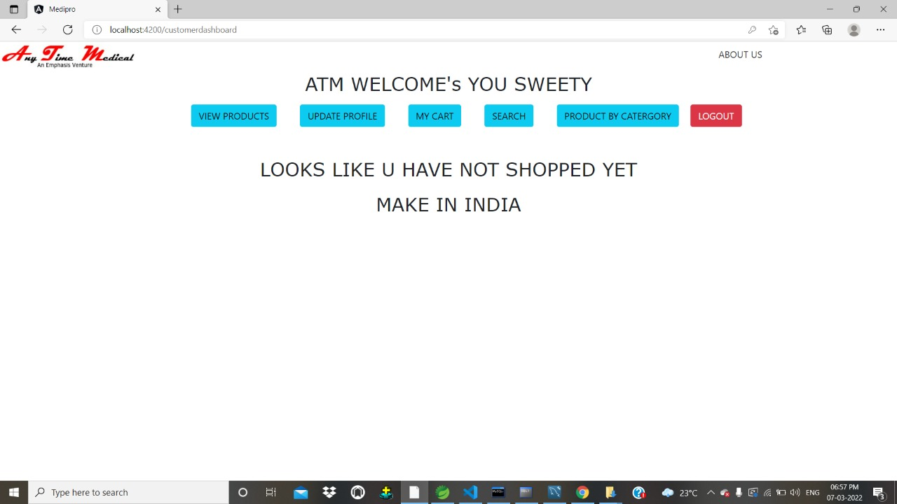
USER LOGIN PAGE:

Slide 28
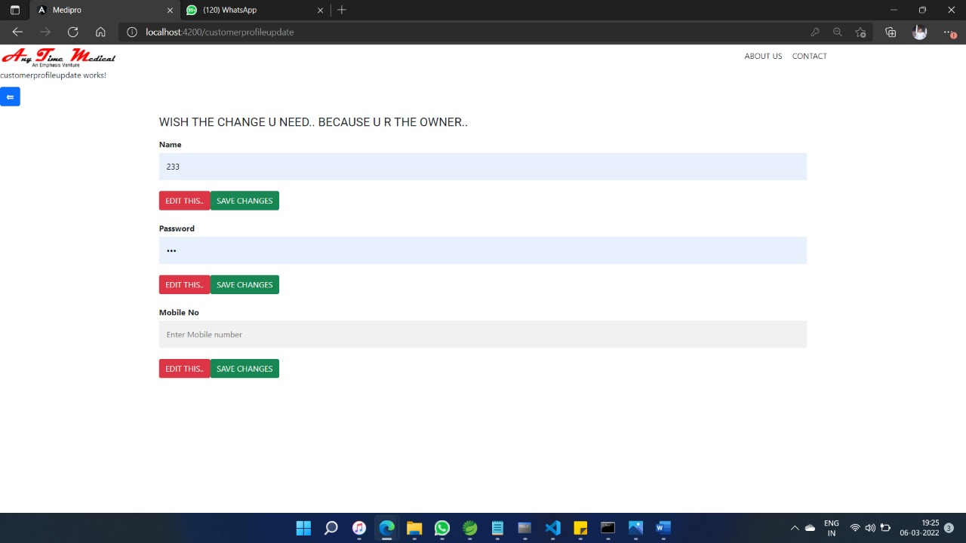
USER UPDATE:

Slide 29
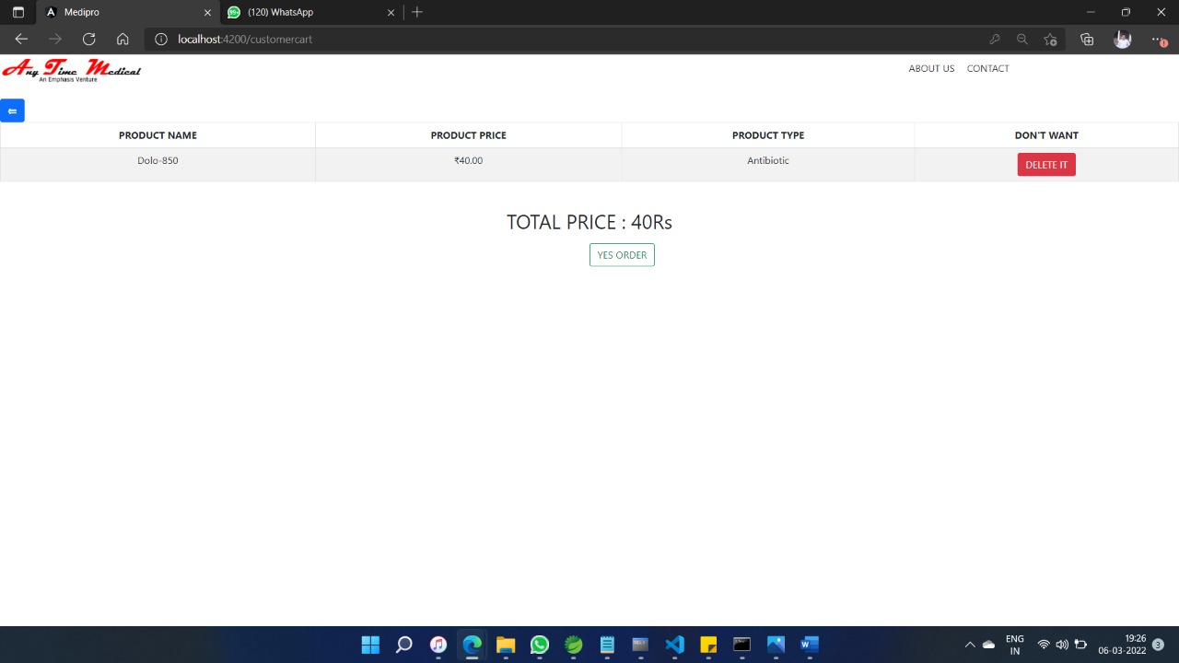
CART PAGE:

Slide 30
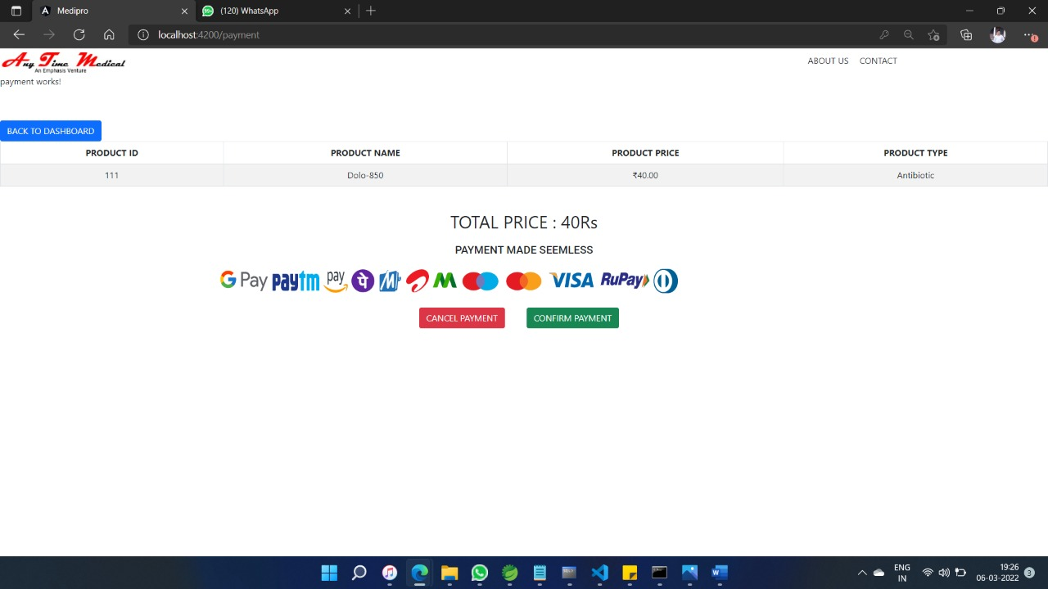
SUMMARY PAGE:

Slide 31
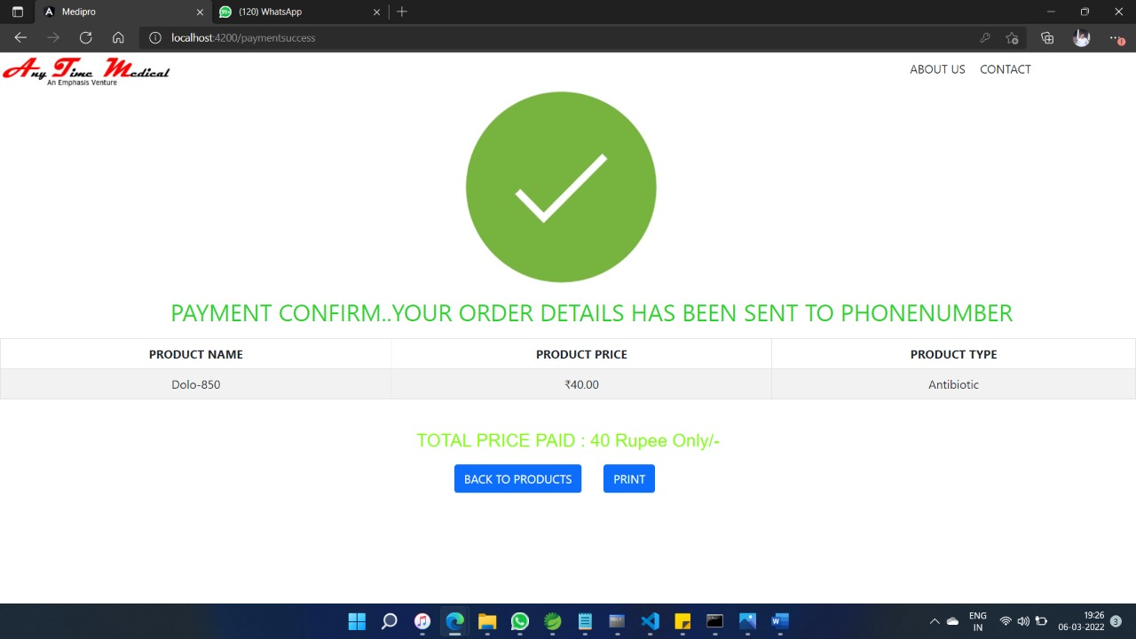
PAYMENT PAGE:

Slide 32
Future scope & Improvements
SMS notification after successful Ordered Medicine.
Encrypted webpages for customer’s privacy.
Online purchase of Products can be provided.
More user friendly interface in smaller screens.
More enhanced searching and sorting.

Slide 33
Bibliography
www.google.com
www.stackoverflow.com
www.w3school.com
https://github.com/DanWahlin/Angular-JumpStart.com
https://www.partech.nl/nl/publicaties/2020/07/9-trending-best-practices-for-rest-api-development.com

Slide 34
CONCLUSION:
online medical system as a web portal. Medical stores also get online business by providing home delivery of medicines to the patient .Thus paper work and lengthy process can be avoided. Since we are entering the details of Admin and User the data will be secured.
With customers becoming digital and wanting to buy everything from the comfort of their home, these industries and businesses should pick up the pace to meet the demand. Medicine industry is one of the biggest industries among all which will thrive at all times.

Slide 35


